Slide 1

PMA: Week-3 Project Time Management Activities – WBS - Scheduling Dr. Bhuvan UNHELKAR Professor of Information Technology www.Unhelkar.com; Office: C225; bunhelkar@sar.usf.edu; 941-359-4654

Slide 2

Lecture Agenda
Overview of Project Time Management
Plan to Manage Schedule in project
Define the Activities for a Work Breakdown Structure (WBS) and Sequence them
Estimate the Resources and Durations for the Activities
Develop a formal Project schedule
Control the Project Schedule in Practice
Undertake Short Exercises
Apply the discussion to the case study

Slide 3

Sub-Module Overview of Project Time Management
Chapter 6 of PMBOK ® v5
© MethodScience; Material Designed and Presented by Dr. B. Unhelkar

Slide 4
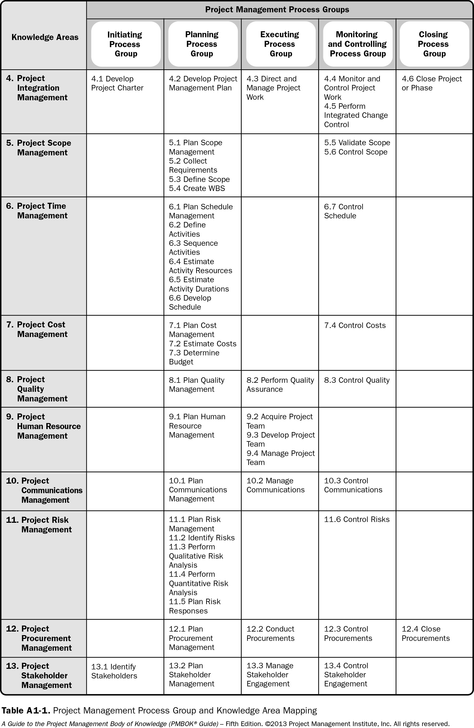
Process Groups – Knowledge Areas

Slide 5
Chapter 6: Project Time Management
6.1 Plan Schedule Management
6.2 Define Activities
6.3 Sequence Activities
6.4 Estimate Activity Resources
6.5 Estimate Activity Durations
6.6 Develop Schedule
6.7 Control Schedule

Slide 6
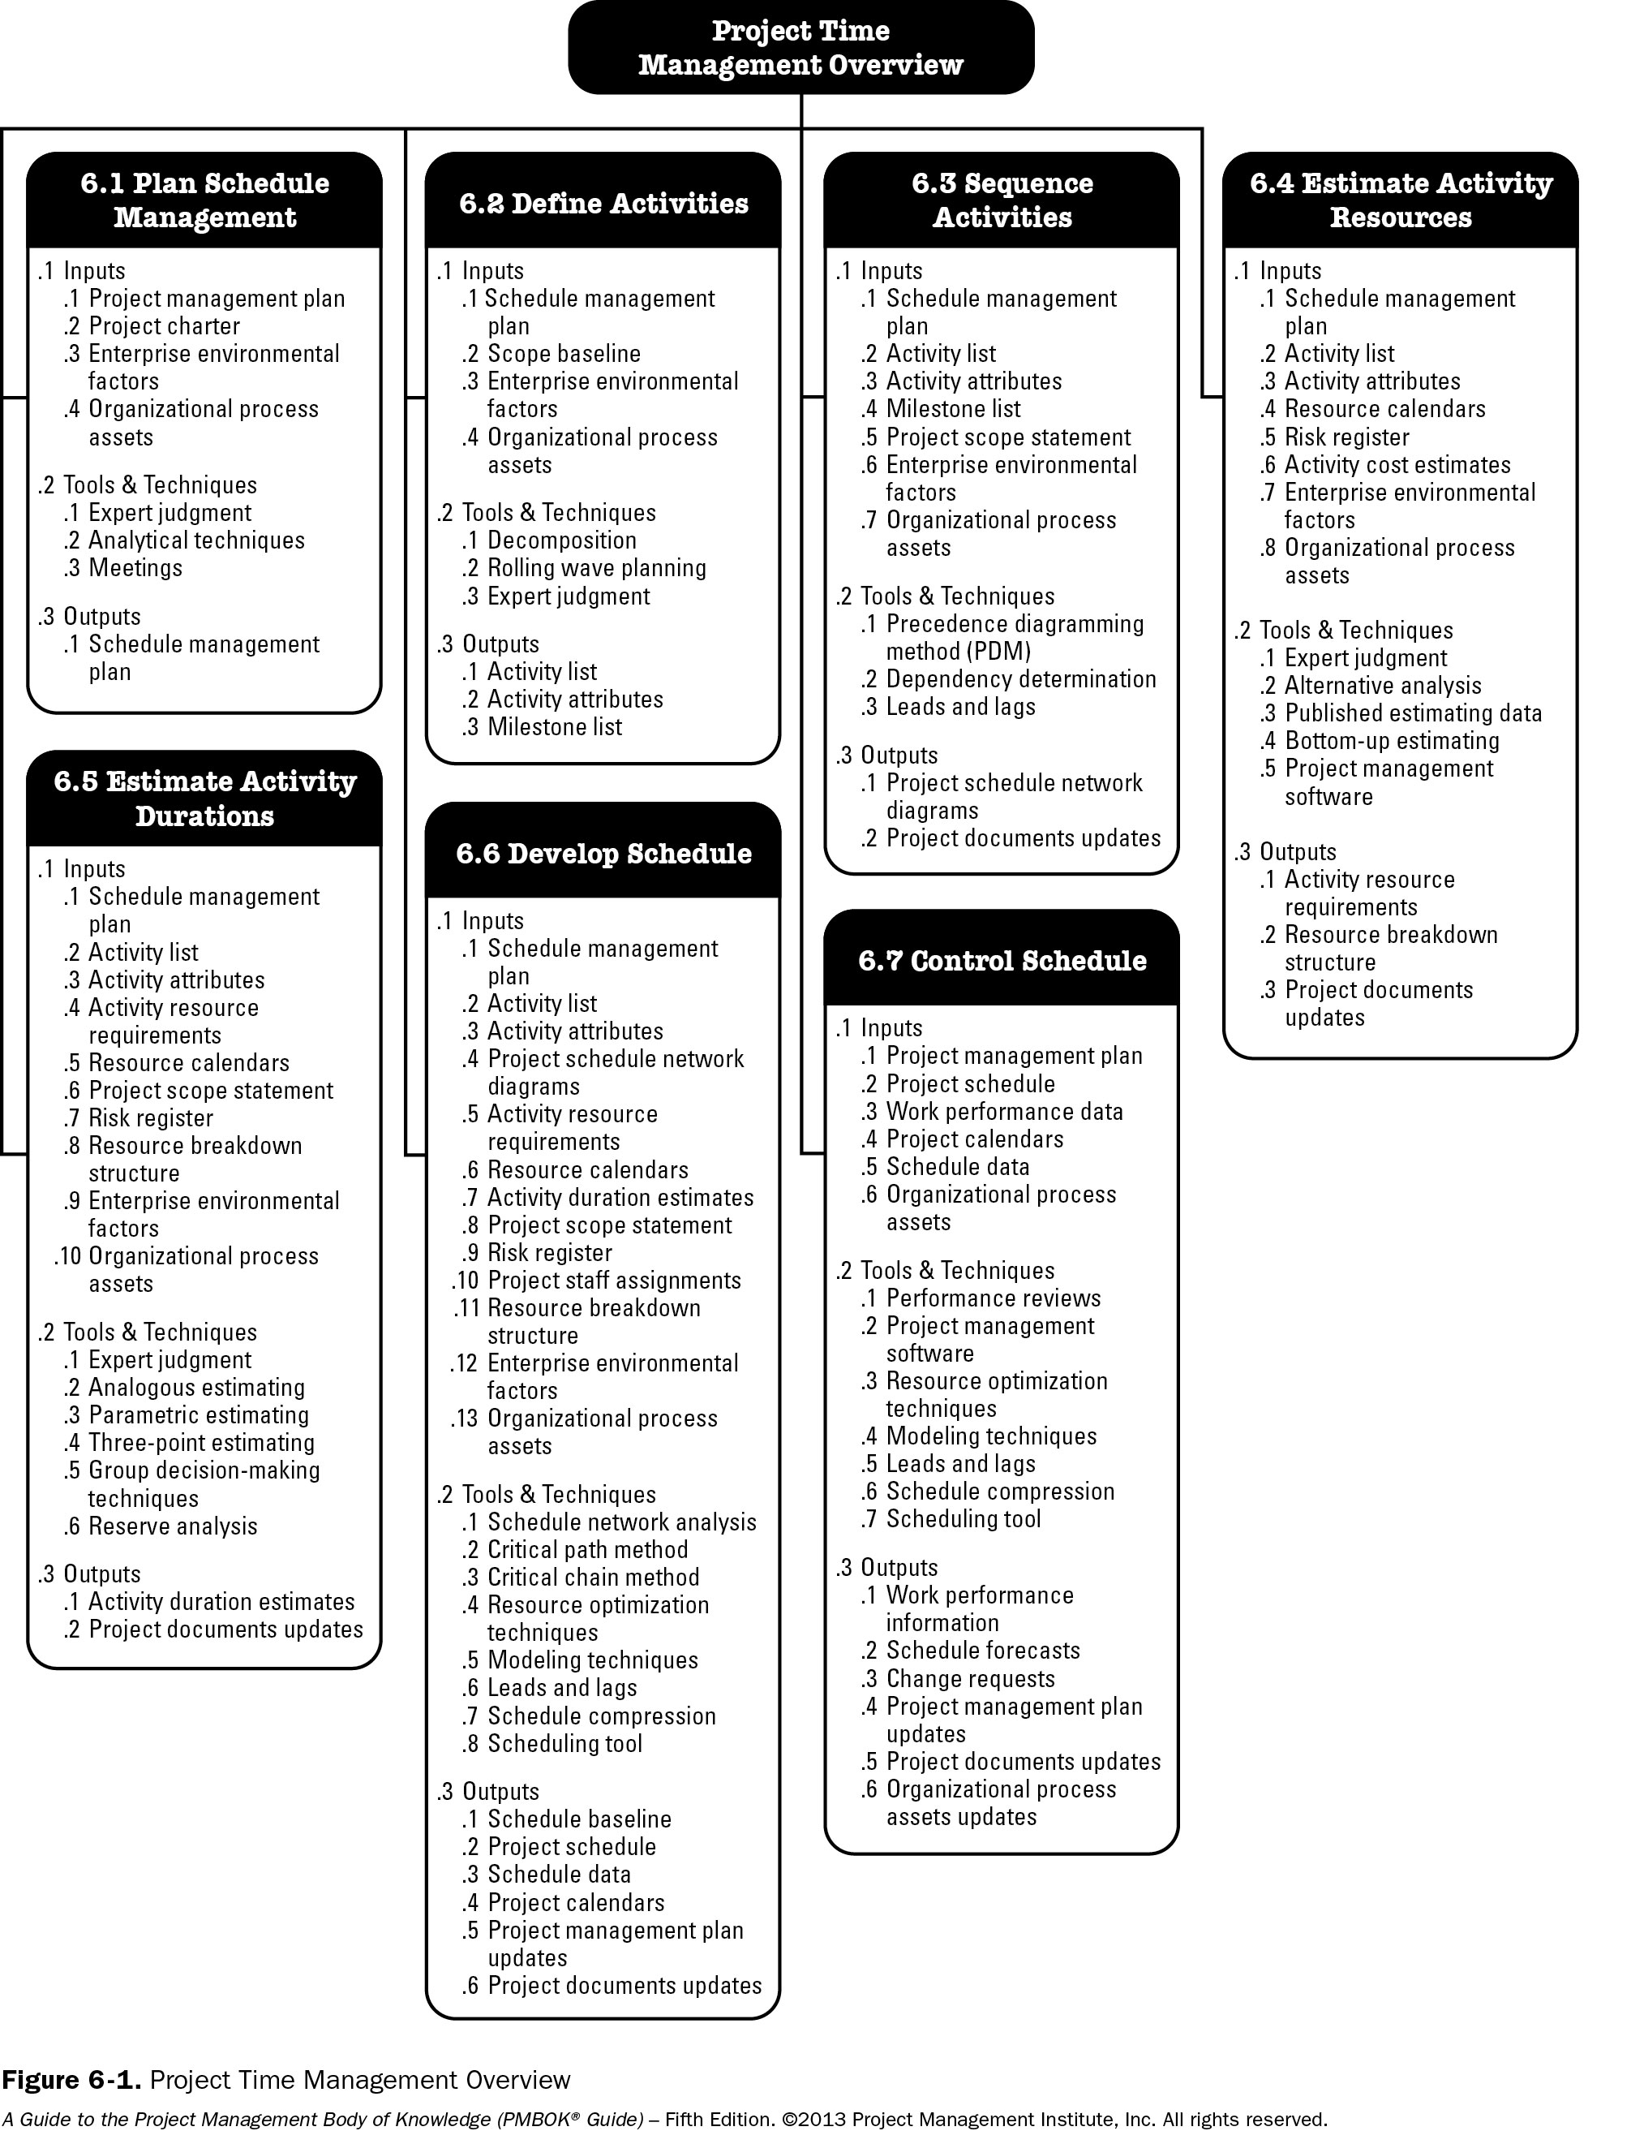
Project Time (Schedule) Management Overview – Chapter 6 of PMBOK ®

Slide 7
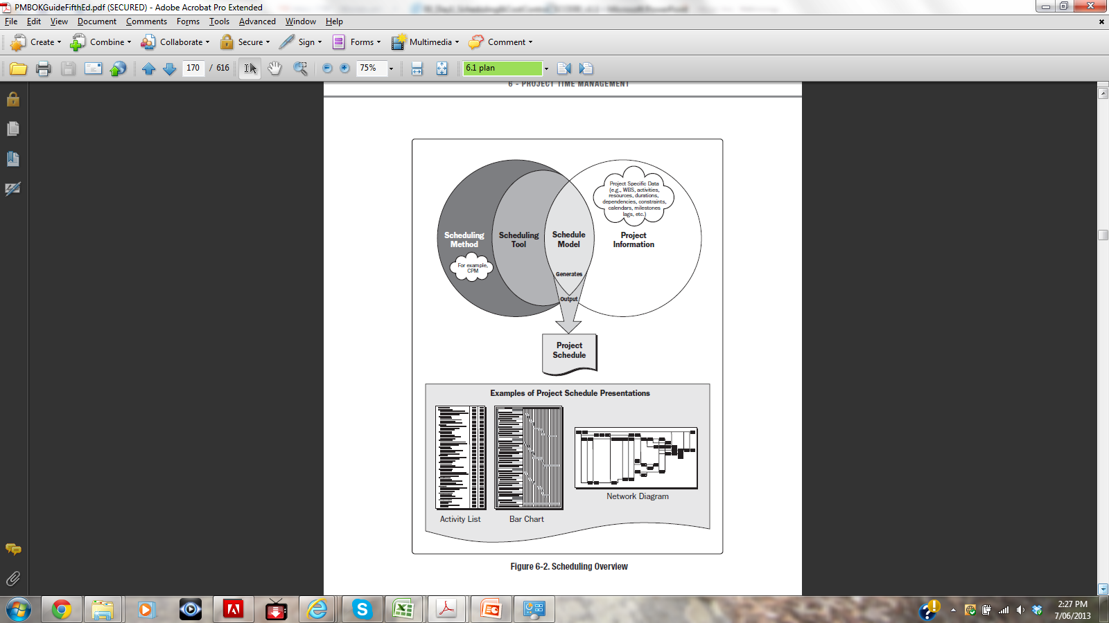
Scheduling Overview

Slide 8
Sub_Module 6.1 Plan Schedule Management
Based on Project Time Management Knowledge Area
(Chapter 6 of PMBOK ® )
MethodScience.com

Slide 9
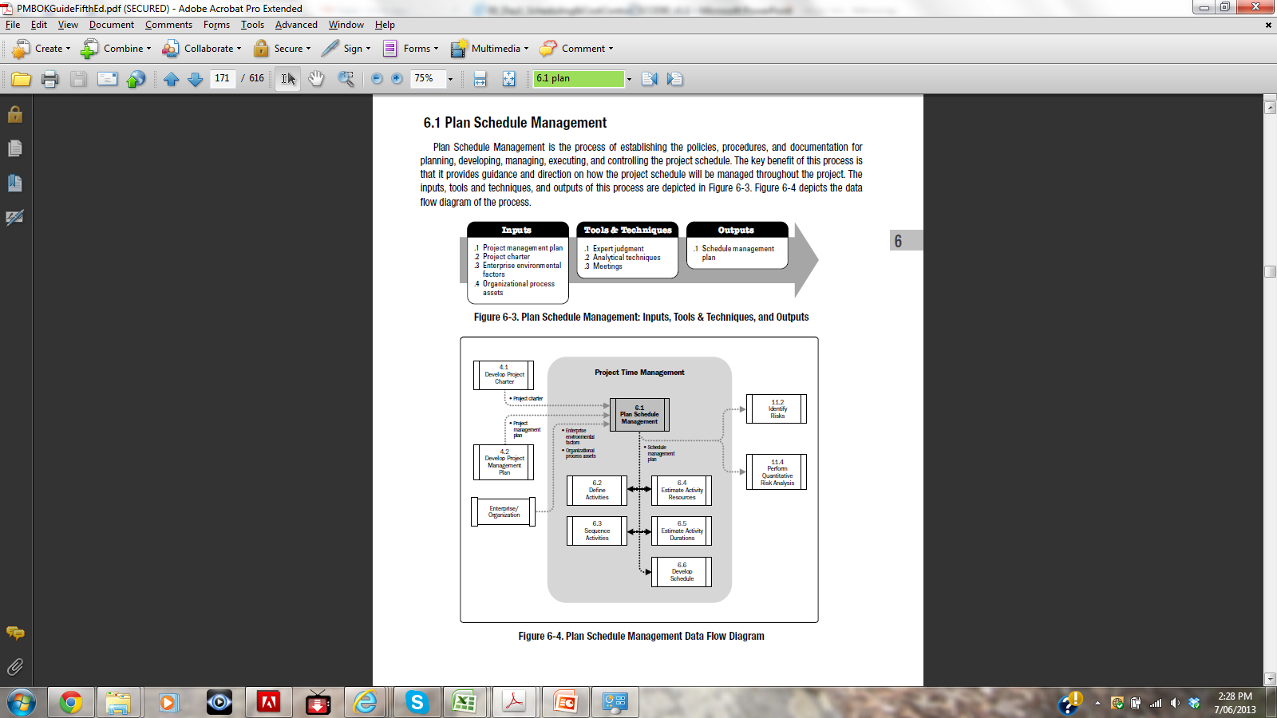
Plan Schedule Management

Slide 10
Inputs to “Plan Schedule Management”
Project Management Plan
Project Charter
Enterprise Environmental Factors
Organizational Process Assets

Slide 11

Tools & Techniques of “Plan Schedule Management”
Expert Judgment
Analytical Techniques
Meetings

Slide 12

Expert Judgment
Expert judgment, guided by historical information, provides valuable insight about the environment
It can also suggest whether to combine methods
Judgment based upon expertise in an application area, Knowledge Area, discipline, industry, etc. should be used in developing the schedule management plan

Slide 13
Analytical Techniques
Scheduling methodology, scheduling tools and techniques, estimating approaches, formats, and project management software
The plan may also detail ways to fast track or crash the project schedule such as undertaking work in parallel
Rolling wave planning
Leads and lags
Alternatives analysis
Methods for reviewing schedule performance

Slide 14

Meetings
Planning meetings to develop the schedule management plan
Participants include the project manager, the project sponsor, selected project team members, selected stakeholders, anyone with responsibility for schedule planning or execution

Slide 15

Outputs of Plan Schedule Management
Schedule management plan Containing:
The Scheduling methodology and tool
Units of Measure and Level of Accuracy
Process used to update the status and progress of the project
Variances (Control thresholds)
Rules associated with Performance Measurement

Slide 16
Sub-Module 6.2 Define Activities
Based on Project Time Management Knowledge Area
(Chapter 6 of PMBOK ® )
MethodScience.com

Slide 17
Project Time (Schedule) Management Overview – Chapter 6 of PMBOK ®

Slide 18
6.2 Define Activities
This “Define Activities” is the process of identifying and documenting the specific actions to be performed to produce the project deliverables.

Slide 19
Inputs to “Define Activities”
Schedule Management Plan
Scope Baseline
Enterprise Environmental Factors
Organizational Process Assets

Slide 20
Tools & Techniques of “Define Activities”
Decomposition
Rolling Wave Planning
Expert Judgment

Slide 21
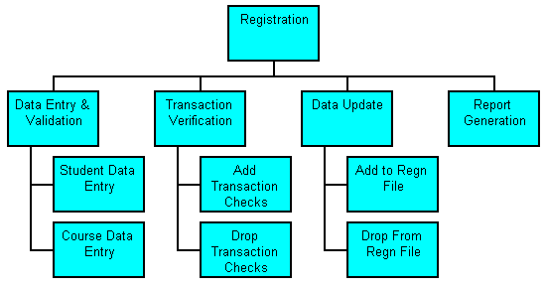
Decomposition
Dividing and subdividing the project scope
Each work package decomposed into the activities required to produce work package deliverables

Slide 22
Rolling Wave Planning
An iterative planning technique
Implying REPEATED planning Exercises
Ranging from High to Low-level plans
Work can exist at various levels of detail depending on where it is in the project life cycle.

Slide 23
Outputs of “Define Activities”
Activity List
Activity Attributes
Milestone List

Slide 24

Activity List
All schedule activities required on the project
Includes the activity identifier
Unique title given to each activity

Slide 25
Activity Attributes
Identifying the multiple components associated with each activity
Activity identifier (ID), WBS ID and activity label
Activity codes, activity description, predecessor activities, successor activities, logical relationships, leads and lags, resource requirements, imposed dates, constraints, and assumptions
Used for selecting, ordering, and sorting the planned schedule activities

Slide 26
Milestone List
Identifying all project milestones
Classifying them into mandatory and optional
Zero duration

Slide 27

Short Exercise – 3.9_Activity List (try 5 here; then go to the actual Templates and enter ALL for your Project)

Slide 28
Short Exercise 3.10_ActivityAttributes – (for any 1 Activity from previous list)

Slide 29
Short Exercise – 3.11_Milestone_List

Slide 30
Sub-Module: 6.3 Sequence Activities
Based on Project Time Management Knowledge Area
(Chapter 6 of PMBOK ® )
MethodScience.com

Slide 31
Project Time (Schedule) Management Overview – Chapter 6 of PMBOK ®

Slide 32
6.3 Sequence Activities
The process of identifying and documenting relationships among the project activities
Impacts the overall output of the project as:
Dependencies between activities needs to be considered
Conflict amongst activities can occur
Parallel Sequencing of activities can Optimize output

Slide 33
Inputs to “Sequence Activities”
Schedule Management Plan
Activity List
Activity Attributes
Milestone List
Project Scope Statement
Enterprise Environmental Factors
Organizational Process Assets

Slide 34
Project Scope Statement
It contains the product scope description, which includes product characteristics
Such as the physical layout of a plant to be constructed or subsystem interfaces on a software project
Project scope statement including project deliverables, project constraints, and project assumptions

Slide 35
Tools & Techniques of “Sequence Activities”
Precedence Diagramming Method (PDM)
Dependency Determination
Leads and Lags

Slide 36
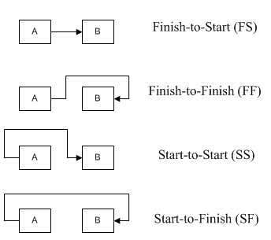
Precedence Diagramming Method (PDM)
It is a technique used for constructing a schedule model
Activities are represented by nodes and are graphically linked by one or more logical relationships
Activity-on-node (AON) is one method of representing a precedence diagram. This is the method used by most project management software packages.
PDM includes four types of dependencies or logical relationships:
Finish-to-start (FS)
Finish-to-finish (FF)
Start-to-start (SS)
Start-to-finish (SF)

Slide 37
Leads and Lags
A lead is the amount of time whereby a successor activity can be advanced with respect to a predecessor activity.
Finish-to-start with a two-week lead
Lead is often represented as a negative value for lag in scheduling software
A lag is the amount of time whereby a successor activity will be delayed with respect to a predecessor activity.
E.g., a technical writing team may begin editing the draft of a large document 15 days after they begin writing it.
Start-to-start relationship with a 15-day lag

Slide 38
Critical Path Method (a simple example)
E
F
5
4
ES=3 EF=7
LS=7 LF=11
Float = 4
ES=7 EF=11
LS=12 LF=15
FLOAT = 4
S=12 F=13
A
G
2
2
S=1 F=2
S=16 F=17
B
C
D
4
6
3
S=3 F=6
S=7 F=12
S=13 F=15
Notes:
Knowing that G starts at 16 means that F can finish as late as 15 WITHOUT AFFECTING THE FINISH TIME OF THE PROJECT. So F can start anywhere between 7 and 12.
Similarly, E can start anywhere between 3 and 7.
We say that E and F both have FLOAT (of 4). Either of these activities could be extended in duration by 4 and not affect the completion time of the project.
If any of A, B, C, D or G take longer than the estimated time then the overall project time will be extended. We say that A, B, C, D and G are the CRITICAL PATH for the project. These tasks require careful management.

Slide 39
Outputs of “Sequence Activities”
Project Schedule Network Diagrams
Project Documents Updates

Slide 40

Short Exercise
What is a (Answer with EXAMPLE for an Activity of Scheduling THIS Lecture):
Lead: ___________________________________
Lag:____________________________________

Slide 41
Sub-Module: 6.4 Estimate Activity Resources
Based on Project Time Management Knowledge Area
(Chapter 6 of PMBOK ® )
MethodScience.com

Slide 42
Project Time (Schedule) Management Overview – Chapter 6 of PMBOK ®

Slide 43
6.4 Estimate Activity Resources
It is the process of estimating the type and quantities of material, human resources, equipment, or supplies required to perform each activity.
It enables more accurate cost and duration estimates.
The Estimate Activity Resources process is closely coordinated with the Estimate Costs process.

Slide 44
Inputs to “ Estimate Activity Resources”
Schedule Management Plan
Activity List
Activity Attributes
Resource Calendars
Risk Register
Activity Cost Estimates
Enterprise Environmental factors
Organizational Process Assets

Slide 45
Resource (People) Calendars
A resource calendar is a calendar that identifies the working days and shifts on which each specific resource is available.
It specifies when and how long identified project resources will be available during the project.
This information may be at the activity or project level.

Slide 46

Risk Register
Risk events may impact resource selection and availability. Updates to the risk register are included with project documents updates.

Slide 47
Tools & Techniques of “ Estimate Activity Resources”
Expert Judgment
Alternative Analysis
Published Estimating Data
Bottom-up Estimating
Project Management Software

Slide 48
Tools and Techniques of “Estimate Activity Resources”
Bottom-Up Estimating.
Method of estimating project duration or cost by aggregating the estimates of the lower-level components of the WBS.
When an activity cannot be estimated with a reasonable degree of confidence, the work within the activity is decomposed into more detail. The resource needs are estimated.
These estimates are then aggregated into a total quantity for each of the activity’s resources. Activities may or may not have dependencies between them that can affect the application and use of resources.
If there are dependencies, this pattern of resource usage is reflected and documented in the estimated requirements of the activity.

Slide 49
Outputs of “ Estimate Activity Resources”
Activity Resource Requirements
Resource Breakdown Structure
Project Documents Updates

Slide 50
3.13_Activity Resource Requirements

Slide 51
Sub-Module: 6.5 - Estimate Activity Durations
Based on Project Time Management Knowledge Area
(Chapter 6 of PMBOK ® )
MethodScience.com

Slide 52
Project Time (Schedule) Management Overview – Chapter 6 of PMBOK ®

Slide 53
6.5 Estimate Activity Durations
It is the process of estimating the number of work periods needed to complete individual activities with estimated resources. It provides the amount of time each activity will take to complete, which is a major input into the Develop Schedule process.
It uses information on activity scope of work , required resource types, estimated resource quantities, and resource calendars.
The inputs of the estimates of activity duration originate from the person or group on the project team who is most familiar with the nature of the work in specific activity.

Slide 54

Inputs to “Estimate Activity Durations”
Schedule Management Plan
Activity List
Activity Attributes
Activity Resource Requirements
Resource Calendars
Project Scope Statement
Risk Register
Resource Breakdown Structure
Enterprise Environmental Factors
Organizational Process Assets

Slide 55
Tools and Techniques of “Estimate Activity Durations”
Expert Judgment
Analogous Estimating
Parametric Estimating
Three-point Estimating
Group Decision-making Techniques
Reserve Analysis

Slide 56
Expert Judgment
Expert judgment, guided by historical information, can provide duration estimate information or recommended maximum activity durations from prior similar projects.
It can also be used to determine whether to combine methods of estimating and how to reconcile differences between them.

Slide 57
Analogous Estimating
It is a technique for estimating the duration or cost of an activity or a project using historical data from a similar activity or project.
It uses parameters from a previous, similar project, such as duration, budget, size, weight, and complexity, as the basis for estimating the same parameter or measure for a future project.
It is a gross value estimating approach, sometimes adjusted for known differences in project complexity.
It is generally less costly and less time consuming than other techniques, but it is also less accurate.

Slide 58
Parametric Estimating
An estimating technique in which an algorithm is used to calculate cost or duration based on historical data and project parameters.
Uses a statistical relationship between historical data and other variables (e.g., square footage in construction) to calculate an estimate for activity parameters, such as cost, budget, and duration.
Activity durations can be quantitatively determined by multiplying the quantity of work to be performed by labor hours per unit of work.
E.g. if the assigned resource is capable of installing 25 meters of cable per hour, the duration required to install 1000 meters is 40 hours. (1000 meters divided by25 meters per hour).

Slide 59
Three-point Estimating
Accuracy of single-point activity duration estimates may be improved by considering estimation uncertainty and risk.
This concept originated with the program evaluation and review technique (PERT).
PERT uses three estimates to define an approximate range for an activity’s duration:
Most likely (tM). This estimate is based on the duration of the activity, given the resources likely to be assigned, their productivity, realistic expectations of availability for the activity, dependencies on other participants, and interruptions.
Optimistic (tO). The activity duration based on analysis of the best-case scenario for the activity.
Pessimistic (tP). The activity duration based on the analysis of the worst-case scenario for the activity.

Slide 60
Three-point Estimating – 1
Depending on the assumed distribution of values within the range of the three estimates the expected duration, tE, can be calculated using a formula.
Triangular distribution. tE = (To + tM + Tp) / 3
Beta distribution (from the traditional PERT technique). tE = (tO + 4tM +Tp) /6

Slide 61
Outputs of “Estimate Activity Durations”
Activity Duration Estimates
Project Documents Updates

Slide 62
Activity Duration Estimates
These are quantitative assessments of the likely number of time periods that are required to complete an activity
Duration estimates do not include any lags
They may include some indication of the range of possible results. For example,
2 weeks +/- 2 days (assuming a five-day workweek);
15 % probability of exceeding three weeks.

Slide 63
3.15_Activity Duration Estimates

Slide 64
Short Exercise
Make an “Activity Duration Estimate” of when *this* Lecture will Complete: (will be in number of minutes) – based on:
Analogous Estimating: __________________________________________
Parametric Estimating: ___________________________________________
Three point Estimating: ___________________________________________

Slide 65
Short Exercise
Now Improve your Answer in previous exercise by undertaking “Group Decision-Making”
By discussing with your colleague
Write the answer below: ___________________

Slide 66
Sub-Module: 6.6 - Develop Schedule
Based on Project Time Management Knowledge Area
(Chapter 6 of PMBOK ® )
MethodScience.com

Slide 67
Project Time (Schedule) Management Overview – Chapter 6 of PMBOK ®

Slide 68
6.6 Develop Schedule
Process of analyzing activity sequences, durations, resource requirements, and schedule constraints to create the project schedule model.
By entering schedule activities, durations, resources, resource availabilities, and logical relationships into the scheduling tool, it generates a schedule model with planned dates for completing project activities.

Slide 69
Tools and Techniques of ‘Develop Schedule”
Schedule Network Analysis
Critical Path Method
Critical Chain Method
Resource Optimisation Techniques
Modelling Techniques
Leads and Lags
Schedule Compression
Scheduling Tool

Slide 70
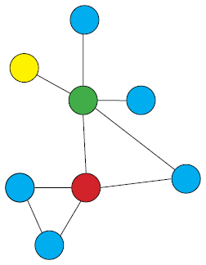
Schedule Network Analysis
It is a technique that generates the project schedule model.
Analytical techniques, such as critical path method, critical chain method, what-if analysis, and resource optimisation techniques.
Calculates the early and late start and finish dates for the uncompleted portions of project activities.

Slide 71
Critical Path Method
Used to estimate the minimum project duration and determine the amount of scheduling flexibility on the logical network paths within the schedule model.
Schedule network analysis technique calculates the early start, early finish, late start, and late finish dates for all activities without regard for any source limitations.
By performing a forward and backward pass analysis through the schedule network.
The critical path is the sequence of activities that represents the longest path through a project.

Slide 72
CPM (a simple example)
Notes:
Suppose we have a project that has activities A through G with estimated durations and sequencing as shown in this table.

Slide 73
CPM (repeating that simple example)
E
F
5
4
ES=3 EF=7
LS=7 LF=11
Float = 4
ES=7 EF=11
LS=12 LF=15
FLOAT = 4
S=12 F=13
A
G
2
2
S=1 F=2
S=16 F=17
B
C
D
4
6
3
S=3 F=6
S=7 F=12
S=13 F=15
Notes:
Knowing that G starts at 16 means that F can finish as late as 15 WITHOUT AFFECTING THE FINISH TIME OF THE PROJECT. So F can start anywhere between 7 and 12.
Similarly, E can start anywhere between 3 and 7.
We say that E and F both have FLOAT (of 4). Either of these activities could be extended in duration by 4 and not affect the completion time of the project.
If any of A, B, C, D or G take longer than the estimated time then the overall project time will be extended. We say that A, B, C, D and G are the CRITICAL PATH for the project. These tasks require careful management.

Slide 74
Critical Path Method..
Without resource consideration
Bhuvan Unhelkar, 2013
74

Slide 75
Critical Path – Network Diagram
Bhuvan Unhelkar, 2006-2013
75

Slide 76
Program Evaluation and Review Technique (PERT)
Network analysis technique used to estimate task duration when there is a high degree of uncertainty about the task itself (i.e.: complexity, skills available)
PERT WEIGHTED AVERAGE = optimistic time x 4 x most likely time x pessimistic time divide by (/) 6
Bhuvan Unhelkar, 2006-2013
76

Slide 77
PERT (2)
Someone thinks it might take about 10 days to complete a task. At best you could do it in 8 days and at worst 24 days. Therefore
PERT WA = 8days + 4 X 10days + 24 days 6
Equals 12 workdays to complete
Can be used as input to CPM
Bhuvan Unhelkar, 2006-2013
77

Slide 78
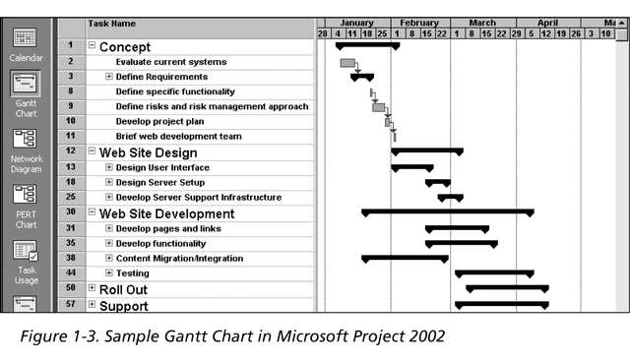
Sample Gantt Chart
The WBS is on the left, and each task’s start and finish date
are shown on the right using a calendar timescale. Early Gantt
Charts, first used in 1917, were drawn by hand.
Bhuvan Unhelkar, 2006-2013
78

Slide 79
Outputs of “Develop Schedule’
Schedule Baseline
Project Schedule
Schedule Data
Project Calendars
Project Management Plan Updates
Project Documents Updates

Slide 80
Short Exercise
What is:
PERT: ___________________________________
CPM:____________________________________

Slide 81
Short Exercise
Create a simple Network Diagram for the process of Traveling from your Home to This Lecture. Have at least THREE paths. Identify and shorten the Critical Path:

Slide 82
Sub-Module: 6.7 - Control Schedule
Based on Project Time Management Knowledge Area
(Chapter 6 of PMBOK ® )
MethodScience.com

Slide 83
Project Time (Schedule) Management Overview – Chapter 6 of PMBOK ®

Slide 84
6.7 Control Schedule
It is the process of monitoring the status of project activities to update project progress and manage changes to the schedule baseline to achieve the plan. It provides the means to recognize deviation from the plan and take corrective and preventive actions and thus minimize risk.
Control schedule, as a component of the Perform Integrated Change Control process, is concerned with:
Determining the current status of the project schedule,
Influencing the factors that create schedule changes,
Determining if the project schedule has changed, and
Managing the actual changes as they occur.

Slide 85

Key Points (Summary)
We discussed All the Tasks required in Project Time Management
These tasks include Identification of the Activities, Estimating the time required to complete them, Assigning Resources (people) to them – and knowing how to Control them
Time planning and management is closely associated with Costs and Scope – Always remember to Coordinate these three
We undertook some exercises following PMBOK – now we put them in the actual project

Slide 86
Conclusions & Future Directions
We discussed…??
Do you see what we see?

Slide 87


References
PMBOK 5th Edition
Project Management for Information Systems – 5th Edition; by James Cadle and Donald Yeates (Pearson, Prentice-Hall), 2008

Slide 88

Project Work (In Group)
1) Revisit your project work – how many templates have you used thus far?
2) You are welcome to modify the templates as also decide which templates you will use – but based on this lecture, you must have a list of Activities, their definitions, their time estimates and a full schedule
3) You will have a MS project file as one major deliverable in which you can apply the PERT/CPM
4) But you will also have a Word document that presents your project management plan, approach and all other deliverables that you are producing here
5) In this week’s project work you definitely need to enter ALL project details in MS Project including Resources, Activities-Tasks and Time Estimates

